Slide 1
10910EECS204001 OJ: #13037 Data Structures Homework 5
2020/12/18 00:00
~
2021/1/1 23:59

Slide 2
HW5
In this homework, you have to implement 2 functions
1. QQ Inversion pairs count
2. K’s largest number

Slide 3
QQ Inversion Pair
Let A be a sequence of numbers.
(i , j) is an QQ inversion pair if i < j but A[i] > 2 * A[j].
Example: A = [1, 2, 3, 4],
then A has no QQ inversion pair.
Example: B = [5, 4, 3, 2 ,1], B has 4 QQ inversion pairs:
(5, 2), (5, 1), (4, 1), (3, 1)

Slide 4
QQ Inversion Pairs Count
Input: a sequence of numbers
Output: the number of QQ inversion pairs
For example: A = [9, 4, 5, 3],
the output is 2.
Because A has inversion pairs: (9, 4), (9, 3).

Slide 5
K’s Largest Number
Input: a sequence of numbers
Output: the k’s largest number of the sequence
For example: A = [179, 208, 306, 93, 859, 984, 55, 9, 271, 33], k = 2
the output is 859.

Slide 6
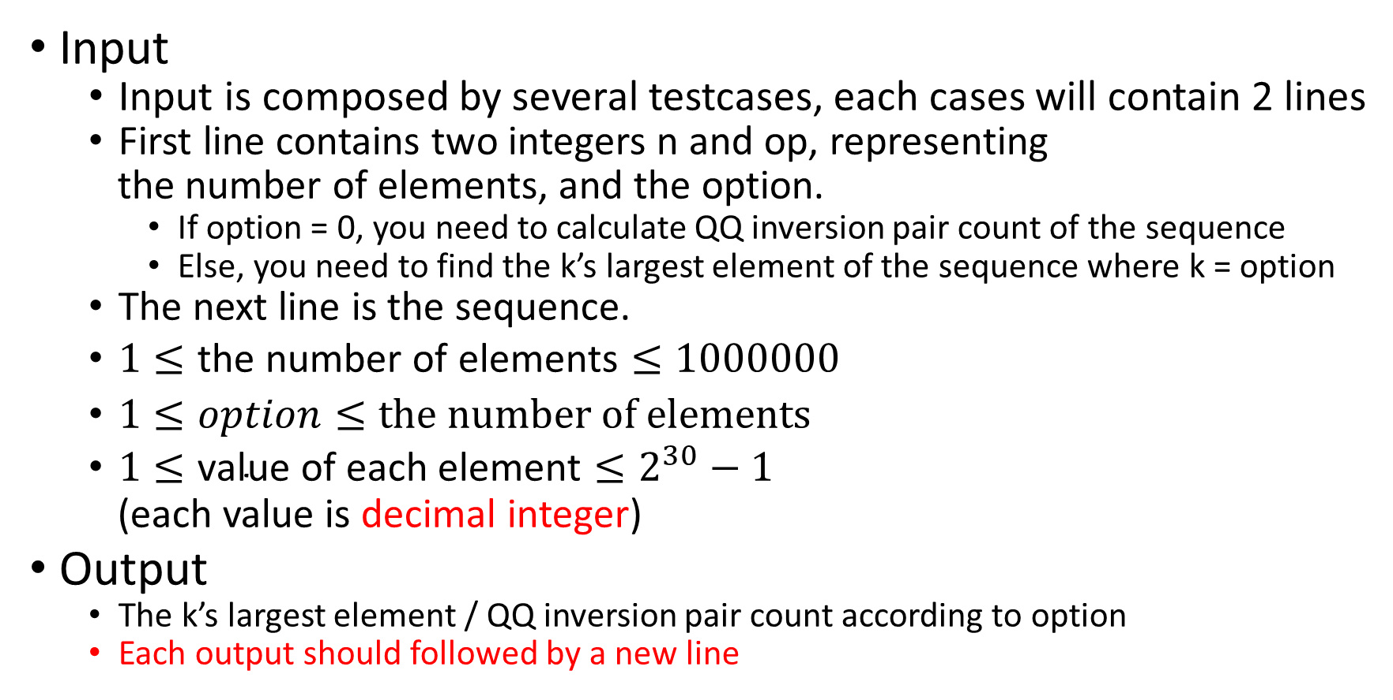
Input & Output
Input
Input is composed by several testcases, each cases will contain 2 lines
First line contains two integers n and op, representing
the number of elements, and the option.
If option = 0, you need to calculate QQ inversion pair count of the sequence
Else, you need to find the k’s largest element of the sequence where k = option
The next line is the sequence.
$1≤\text{the} \text{number} \text{of} \text{elements}≤1000000$
$1≤option≤\text{the} \text{number} \text{of} \text{elements}$
$1≤\text{value} \text{of} \text{each} \text{element}≤2^{30}−1$
(each value is decimal integer)
Output
The k’s largest element / QQ inversion pair count according to option
Each output should followed by a new line

Slide 7
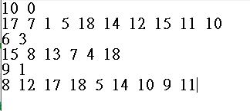
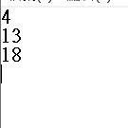
Sample Input & Sample Output
Input
Output
Note : There is a new line at the end of the output,
but no new line at the end of the input

Slide 8
STL
You are allowed to use STL.
But don’t use any STL related to sort.

Slide 9
The End

